Slide 1
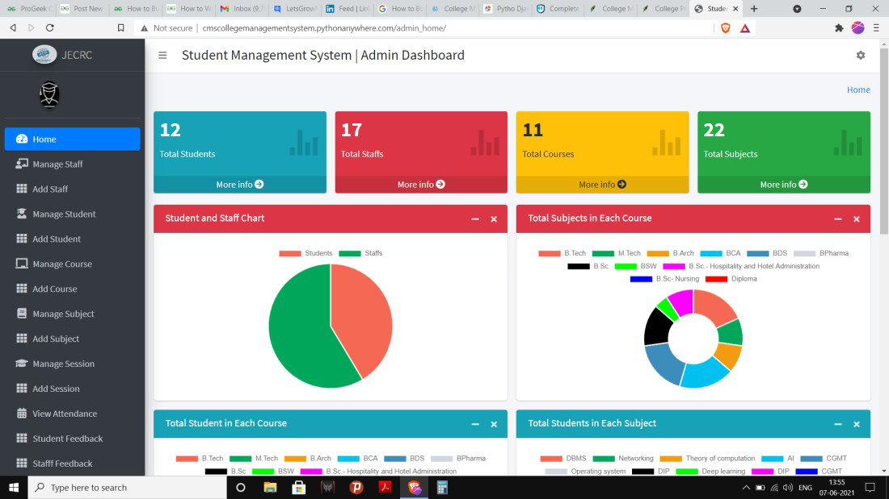
. For Head Of Department(HOD): The below image shows the interface for the Head of Departments of the College:

Slide 2
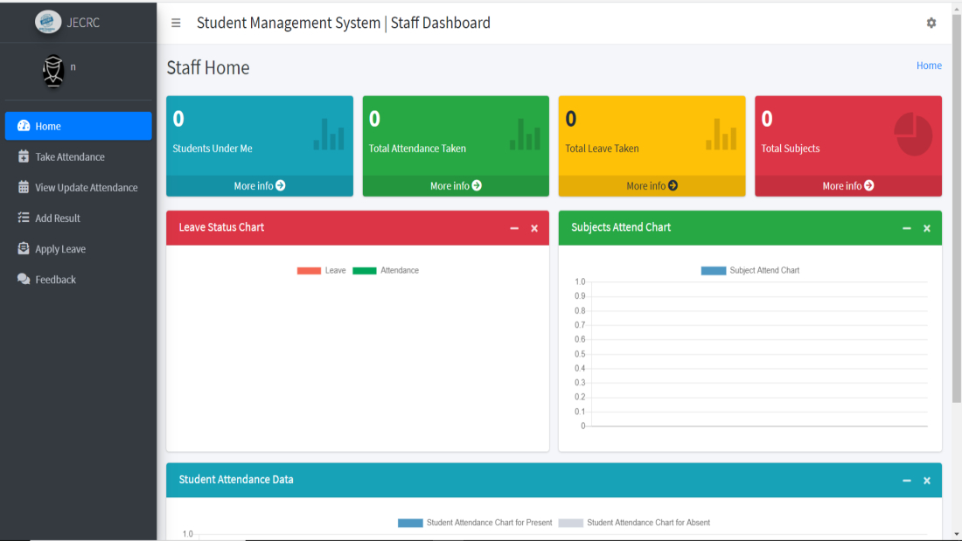
2. For Staff:
The below image shows the interface for the Staff of the College:
Staff

Slide 3
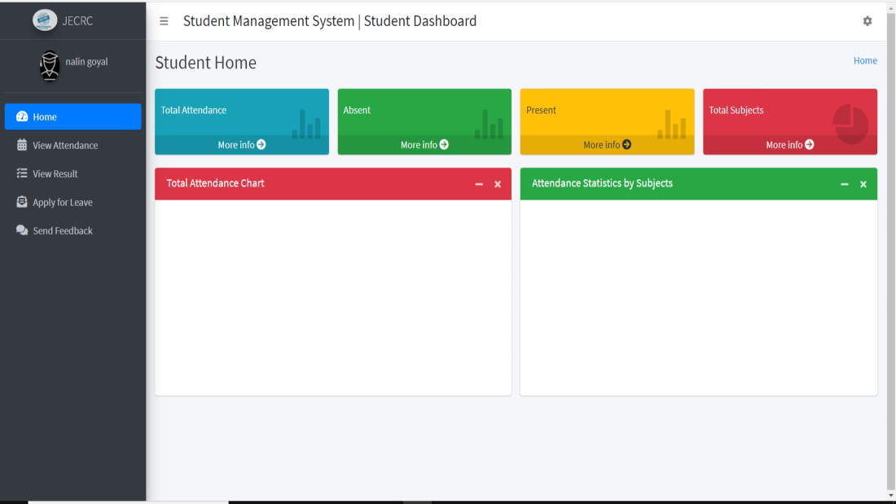
. For Students:
The below image shows the interface for the Students of the College:

Slide 4
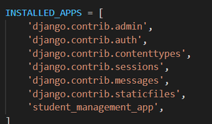
tep 5: Go to student_management_project -> settings.py -> INSTALLED_APPS and add our app ‘student_management

Slide 5
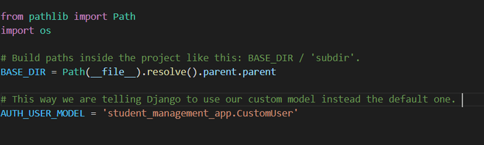
Step 13: Go to student_management_project -> setting and add AUTH_USER_MODEL = ‘student_management_app.CustomUser’.

Slide 6
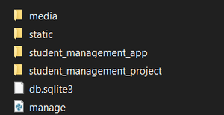
tep 16: Now Create a new folder as templates which includes Student_template, Hod_template, Staff_template folders. It contains the different templates used in each interface. Create another folder as static which also includes some files. ( Note – All these folders must be in student_management_project ). All these files can be downloaded from here.

Slide 7
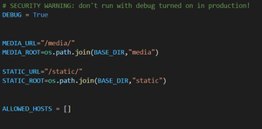
import os MEDIA_URL="/media/" MEDIA_ROOT=os.path.join(BASE_DIR,"media") STATIC_URL="/static/" STATIC_ROOT=os.path.join(BASE_DIR,"static")

Slide 8
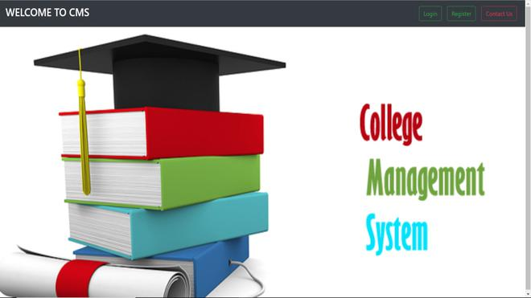
Output :

Slide 9
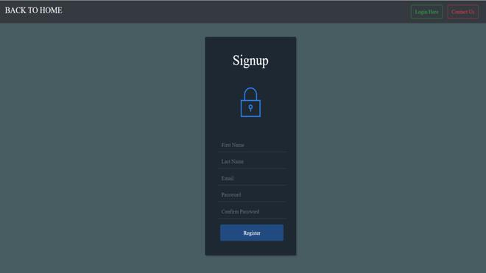
Output:

Slide 10
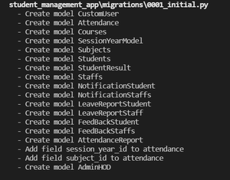
Step 23: Run these commands to migrate your models into the database. When you successfully do all the steps you will get this type of output in CMD. python manage.py makemigrations

